Slide 1

Universal Human Values
(BUHK408)
An introduction to the core aspirations of sustained happiness and prosperity for all human beings.
MM
by MOHAMMAD TAHIR MIRJI

Slide 2
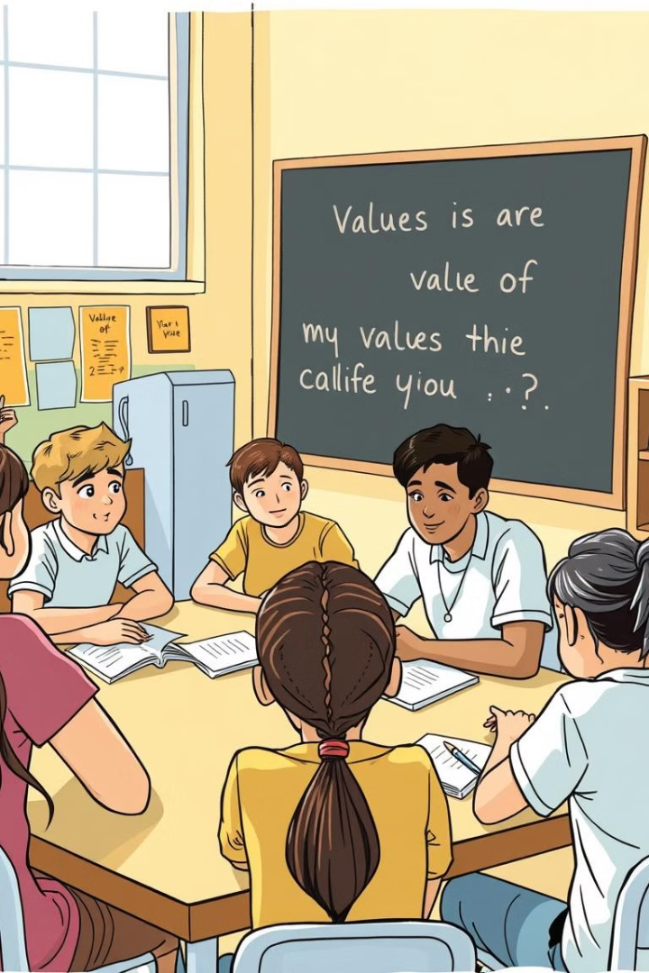
Course Objectives
1
Values & Skills
2
Holistic Perspective
Appreciate essential complementarity.
Towards life, profession, happiness.
3
Ethical Conduct
Trustful, fulfilling human behavior.

Slide 3




Teaching-Learning Process
Explorational
Innovative
Real-Life
Systematic study of human existence.
Develop theoretical and applied skills.
Provide real-life examples.

Slide 4
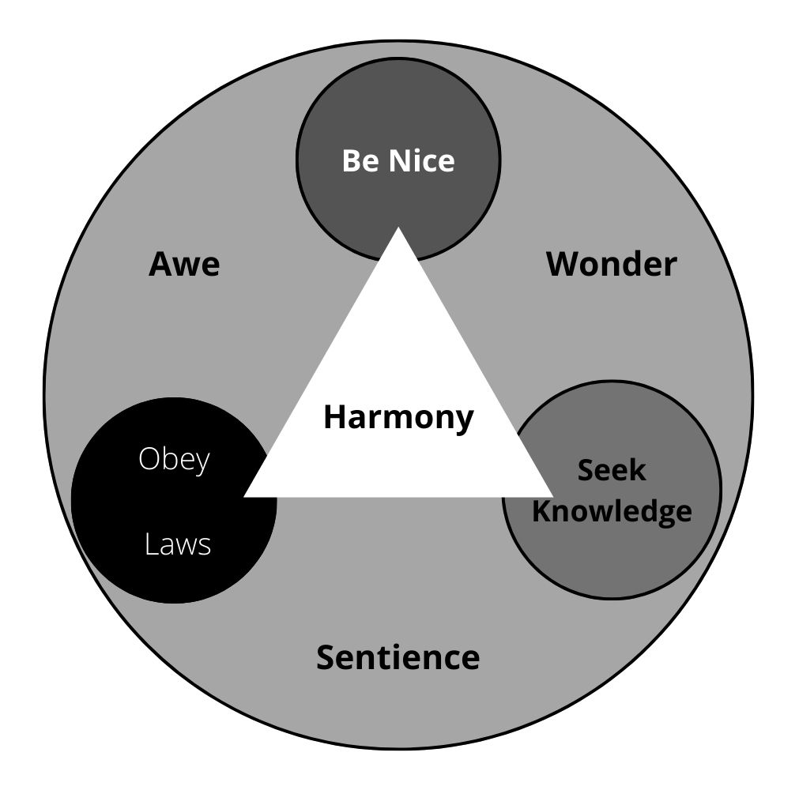
Harmony in the Human Being
Self & Body
Self-Regulation
Co-existence of self and body.
Programme to ensure self-regulation.
Needs
Distinguish needs of self and body.

Slide 5




Harmony in Family & Society
Family Unit
Basic unit of human interaction.
Trust
Foundational value in relationship.
Justice
Human-to-human relationship.

Slide 6



Harmony in Nature/Existence
2
Self-Regulation
Interconnectedness
1
3
Mutual Fulfilment

Slide 7

Professional Ethics
Human Values
Humanistic Education
Natural acceptance of human values.
Basis for humanistic education.
Value-Based Life
Strategies for transition.

Slide 8

Course Outcomes
1
Awareness
2
Responsibility
More aware of self and surroundings.
More responsible in life.
3
Critical Ability
Better critical ability.

Slide 9
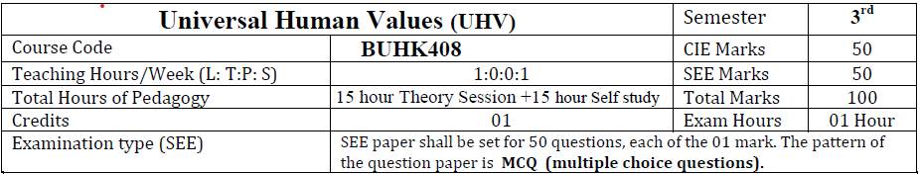
Pedagogy

Slide 10
Course Outcomes
At the end of the course, students are expected to become more aware of themselves, and their surroundings (family, society, nature);
They would become more responsible in life, and in handling problems with sustainable solutions, while keeping human relationships and human nature in mind.
They would have better critical ability.
They would also become sensitive to their commitment towards what they have understood (human values, human relationship and human society).
It is hoped that they would be able to apply what they have learnt to their own self in different day-to-day settings in real life, at least a beginning would be made in this direction.
Expected to impact common graduate attributes like: Positively
1. Ethical human conduct
2. Socially responsible behaviour
3. Holistic vision of life
4. Environmentally responsible work
5. Having Competence and Capabilities for Maintaining Health and Hygiene
6. Appreciation and aspiration for excellence (merit) and gratitude for all

Slide 11
Course Outcomes
Assessment Details (both CIE and SEE)
The weightage of Continuous Internal Evaluation (CIE) is 50% and for Semester End Exam (SEE) is 50%. The minimum passing mark for the CIE is 40% of the maximum marks (20 marks out of 50) and for the SEE minimum passing mark is 35% of the maximum marks (18 out of 50 marks). The student is declared as a pass in the course if he/she secures a minimum of 40% (40 marks out of 100) in the sum total of the CIE (Continuous Internal Evaluation) and SEE (Semester End Examination) taken together
Continuous internal Examination (CIE)
For the Assignment component of the CIE, there are 25 marks and for the Internal Assessment Test component, there are 25 marks.
The first test will be administered after 40-50% of the syllabus has been covered, and the second test will be administered after 85-90% of the syllabus has been covered
Any two assignment methods mentioned in the 22OB2.4, if an assignment is project-based then only one assignment for the course shall be planned. The teacher should not conduct two assignments at the end of the semester if two assignments are planned.
For the course, CIE marks will be based on a scaled-down sum of two tests and other methods of assessment.
The sum of two tests, two assignments, will be out of 100 marks and will be scaled down to 50 marks

Slide 12
Semester End Examinations (SEE) Evaluation
SEE paper shall be set for 50 questions, each of the 01 marks.
The pattern of the question paper is MCQ (multiple choice questions).
The time allotted for SEE is 01 hour. The student has to secure a minimum of 35% of the maximum marks meant for SEE.

Slide 13
Books for READING:
Text Book and Teachers Manual
a. The Textbook A Foundation Course in Human Values and Professional Ethics, R R Gaur, R Asthana, G P Bagaria, 2nd Revised Edition, Excel Books, New Delhi, 2019. ISBN 978-93-87034- 47-1
b. The Teacher‟s Manual for A Foundation Course in Human Values and Professional Ethics, R R Gaur, R Asthana, G

